Slide 1
Đồ án tốt nghiệp
QUẢN LÝ ĐIỂM SINH VIÊN
TRƯỜNG ĐẠI HỌC KEVIN

Slide 2
01
02
03
04
GIỚI THIỆU VÀ KHẢO SÁT
GIỚI THIỆU VỀ CÔNG NGHỆ
PHÂN TÍCH VÀ THIẾT KẾ
TRIỂN KHAI VÀ KẾT QUẢ ĐẠT ĐƯỢC

Slide 3
01
GIỚI THIỆU VÀ KHẢO SÁT

Slide 4

Giới thiệu chung về bài toán quản lý

Slide 5
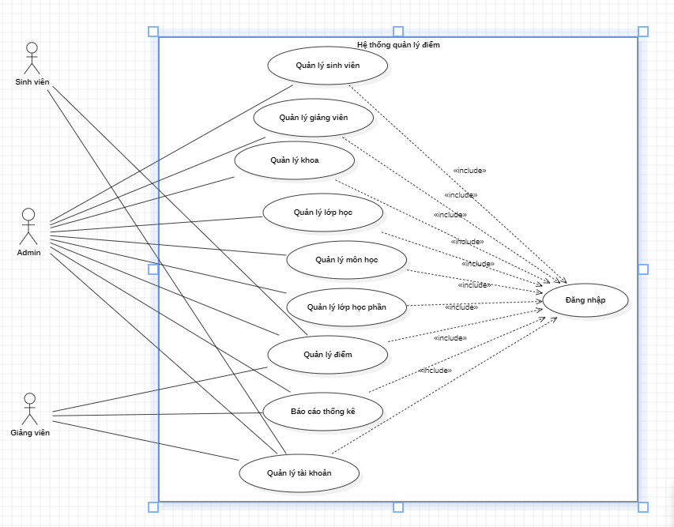
Usecase tổng quát
- Các tác nhân chính: Admin, giảng viên, sinh viên.

Slide 6
Understanding the Problem
Neptune
Mercury
Jupiter
Neptune is the farthest planet from the Sun
Mercury is the smallest planet in the Solar System
Jupiter is the biggest planet in the Solar System

Slide 7
Main Competitors
 | Mercury | Jupiter | Venus | Neptune

Slide 8
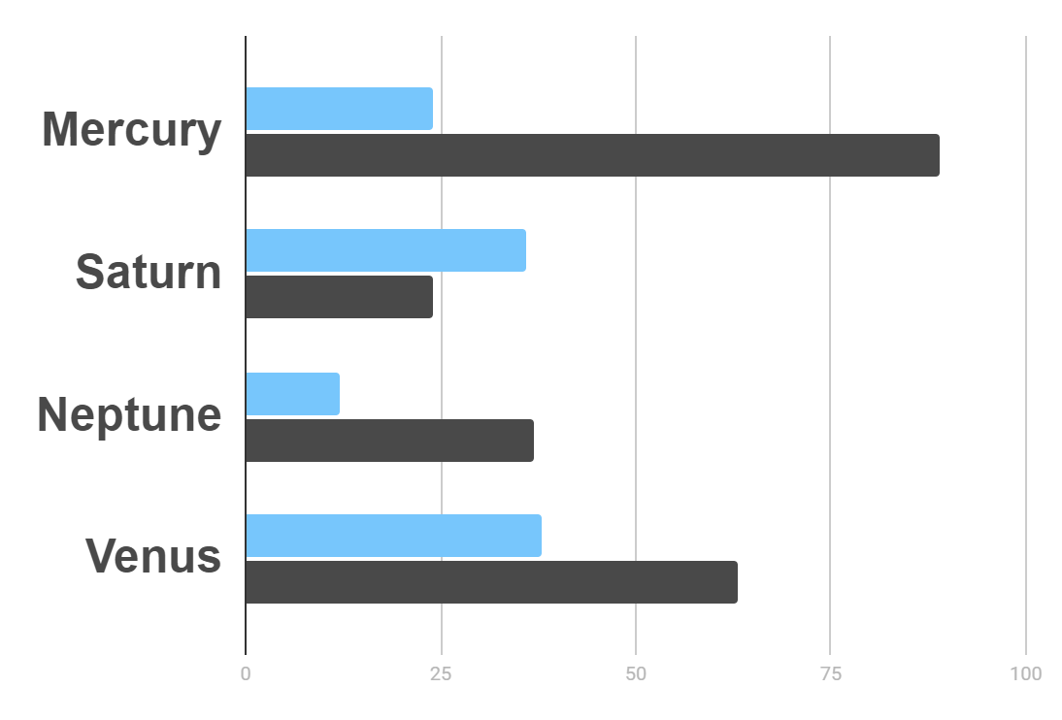
Market Research
Evolution
$20K
Gross Revenue in the Sector
10%
45K
To modify this graph, click on it, follow the link, change the data and paste the resulting graph here
Sector Growth

Slide 10
Awesome Words

Slide 11
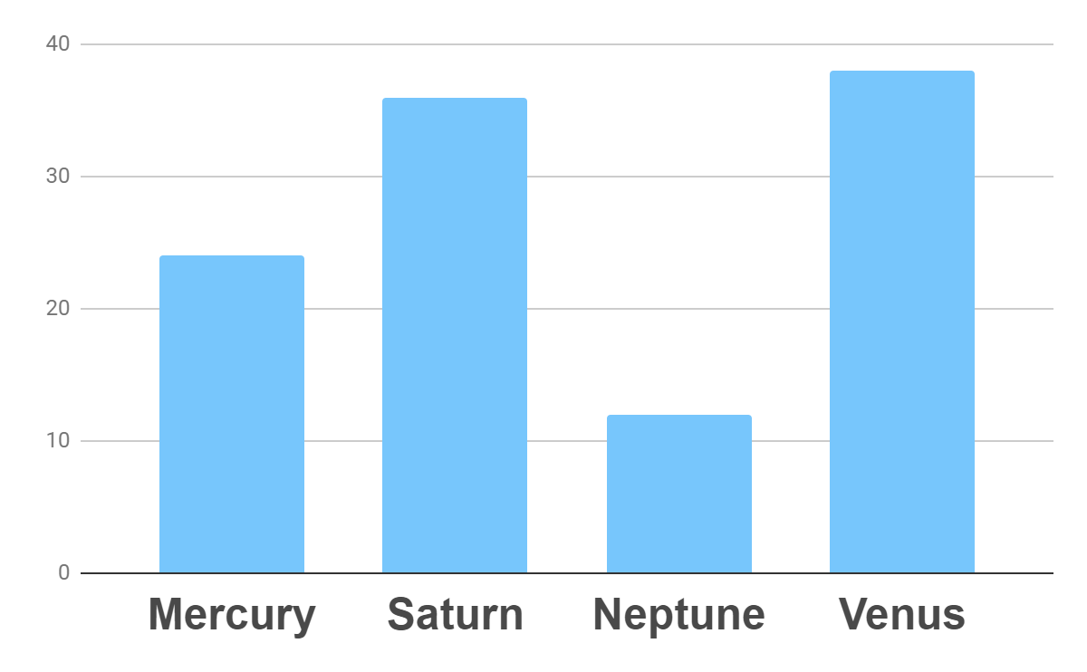
Analysis
Outreach
Top Rated Values
To modify this graph, click on it, follow the link, change the data and paste the new graph here

Slide 12
333,000.00
24h 37m 23s
386,000 km
earths is the sun’s mass
is Jupiter’s rotation period
is the distance to the Moon

Slide 13
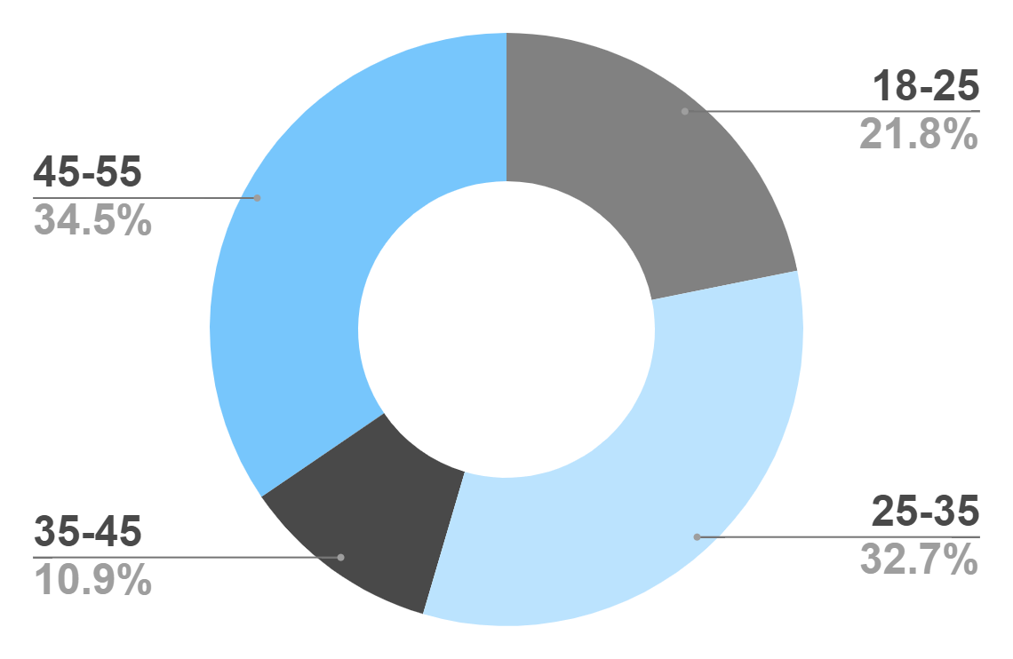
Target
Age
Gender
30%
70%
Interests
Security
Usability
To modify this graph, click on it, follow the link, change the data and paste the new graph here
Interface

Slide 14
Our Process
Mercury is the closest planet to the Sun
Venus is the second planet from the Sun
Day 1
Day 2
Day 3
Day 4
Jupiter is the biggest planet in the Solar System
Neptune is the farthest planet from the Sun

Slide 15
Whoa!
This could be the part of the presentation where you can introduce yourself, write your email…

Slide 16
Our Consultants
John James
Venus is the second planet from the Sun
Jane Patterson
Joe Doe
Mercury is the closest planet to the Sun
Neptune is the farthest planet from the Sun

Slide 17
Our Partners
Mercury
Jupiter
Neptune
Mercury is the closest planet to the Sun
Jupiter is the biggest planet of them all
Neptune is the farthest planet from the Sun
Saturn
Mars
Venus
Saturn is the ringed one and a gas giant
Despite being red, Mars is actually a cold place
Venus is the second planet from the Sun

Slide 18
Testimonials
Helena James
“Mercury is the closest planet to the Sun”
Jenna Doe
“Jupiter is the biggest planet of them all “
Mary Patterson
“Neptune is the farthest planet from the Sun”

Slide 19
Awards
Mercury
It’s the closest planet to the Sun
Venus
Venus is the second planet from the Sun
Jupiter
Jupiter is the biggest planet of them all

Slide 20
498,300,000
Big numbers catch your audience’s attention

Slide 21
Upcoming Goals
January
February
March
April
Goal 1
Phase 1
Phase 2

Slide 22
The Slide Title Goes Here!
Do you know what helps you make your point clear? Lists like this one:
They’re simple
You can organize your ideas clearly
You’ll never forget to buy milk!
And the most important thing: the audience won’t miss the point of your
presentation

Slide 23

A Picture Is Worth a Thousand Words

Slide 24
Infographics Make Your Idea
Understandable…
Mercury
Neptune
Mercury is the closest planet to the Sun
Neptune is the farthest planet from the Sun
Jupiter
Saturn
Jupiter is the biggest planet of them all
Saturn is the ringed one and a gas giant

Slide 25
…And the Same Goes for Tables
 | Mass (earths) | Diameter (earths) | Gravity (earths)
Mercury | 0.06 | 0.38 | 0.38
Mars | 0.11 | 0.53 | 0.38
Saturn | 95.2 | 9.4 | 1.16

Slide 26
Maybe You Need to Divide the Content
01
02
Neptune
Jupiter
Neptune is the farthest planet from the Sun and the fourth-largest in the Solar System
Jupiter is the biggest planet in the Solar System and the fourth-brightest one

Slide 27
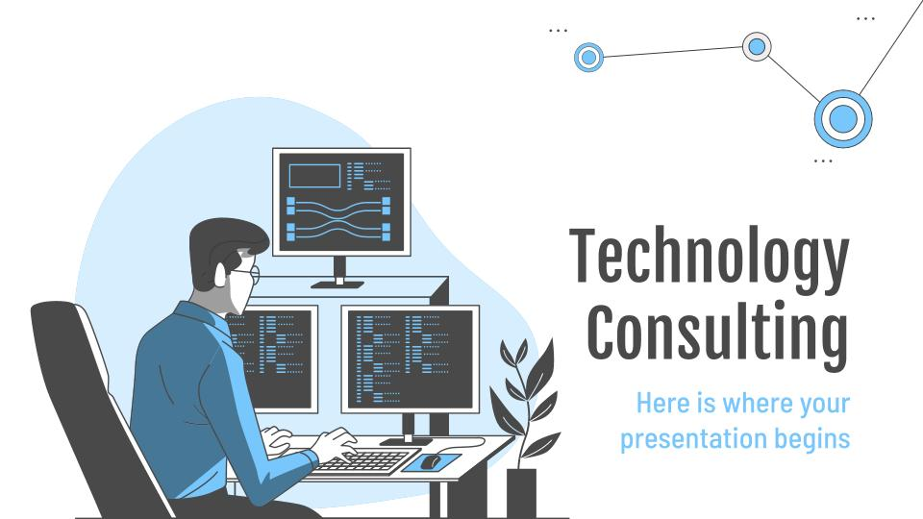
Desktop Software
You can replace the image on
the screen with your own
work. Just delete this one,
add yours and center it properly

Slide 28
Thanks!
Do you have any questions?
youremail@freepik.com
+91 620 421 838
yourcompany.com
Please keep this slide for attribution

Slide 29
Alternative Resources
Find more illustrations like these on Stories by Freepik

Slide 30
Resources
Vectors
Programming
Development
Mission impossible
Social networking
Segmentation
Site stats
Responsive
Meeting
Analysis
Cyber attack
Secure server
Control panel
Photos
Close-up of woman using a laptop
Beautiful young woman holding laptop on pink backdrop
Icons
Project Management Icon
Find more illustrations like these on Stories by Freepik

